Slide 1
DIGITAL LOGIC WITH VHDL DESIGN
DR TIN THET NWE

Slide 2
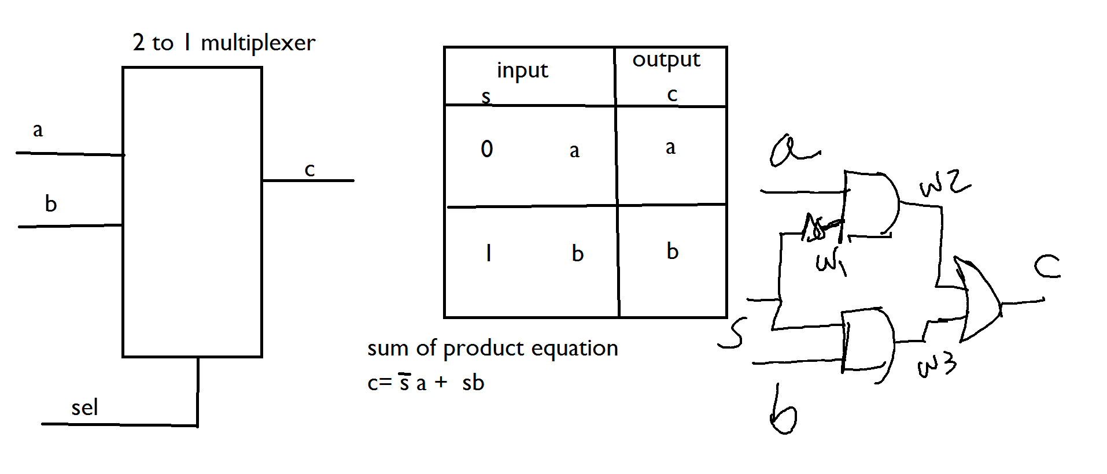
2 to 1 multiplexer using logical operator

Slide 3
2 to 1 multiplexer using logical operator
library IEEE;
use IEEE.STD_LOGIC_1164.ALL;
entity eg2 is
( a,b,s: in std_logic;
c: out std_logic;
);
end eg2;
architecture logic_function of eg2 is
signal w1,w2,w3: std_logic;
begin
w1<= not s;
w2 <= w1 and a ;
w3<= s and b;
c <= w2 or w3;
end logic_function;

Slide 4
2 to 1 multiplexer using selected signal assignment
library IEEE;
use IEEE.STD_LOGIC_1164.ALL;
entity eg2 is
( a,b,s: in std_logic;
c: out std_logic
);
end eg2;
architecture logic_function of eg2 is
begin
with s select
c<= a when ‘0’
b when ‘1’;
end logic_function;

Slide 5
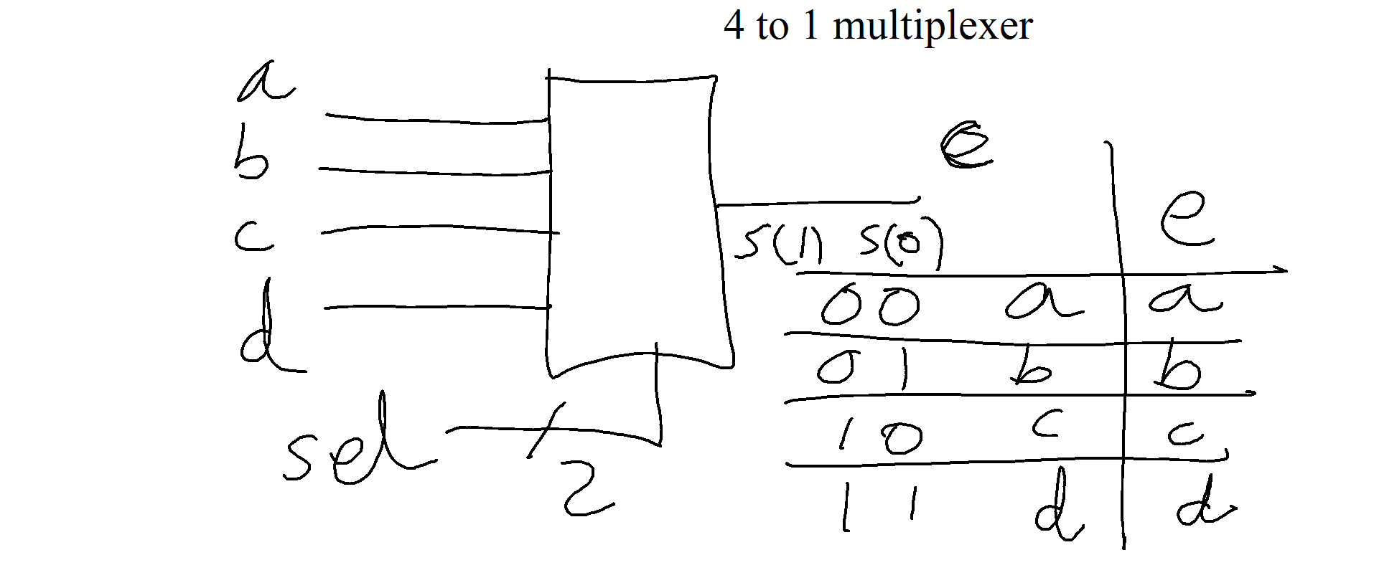
Multiplexer using conditional signal assignment
4 to 1 multiplexer

Slide 6
4 to 1 multiplexer using selected signal assignment
library IEEE;
use IEEE.STD_LOGIC_1164.ALL;
entity eg2 is
( a,b,c,d: in std_logic;
s : in std_logic_vector ( 1 downto 0);
e: out std_logic
);
end eg2;
architecture logic_function of eg2 is
begin
with s select
e<= a when “00”,
b when “01”,
c when “10” ,
d when “11”;
end logic_function;

Slide 7
4 to 1 multiplexer using instances of 2 to 1 mux
Using a selected signal assignment, write VHDL code for 2-to-1 multiplexer using entity name mux2To1. Also write VHDL code for 4-to-1 multiplexer using three instances of entity mux2To1.

Slide 8
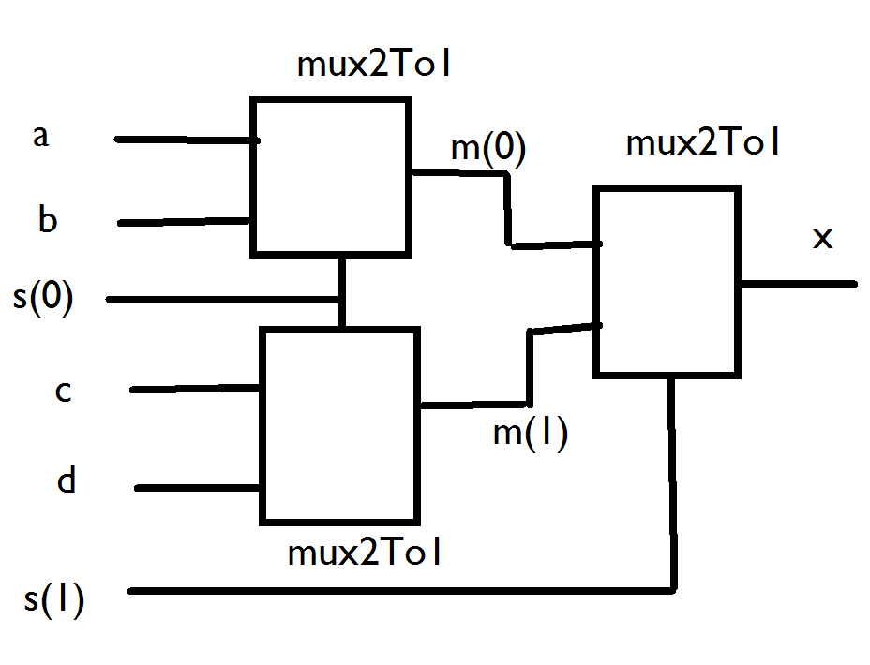

Slide 9
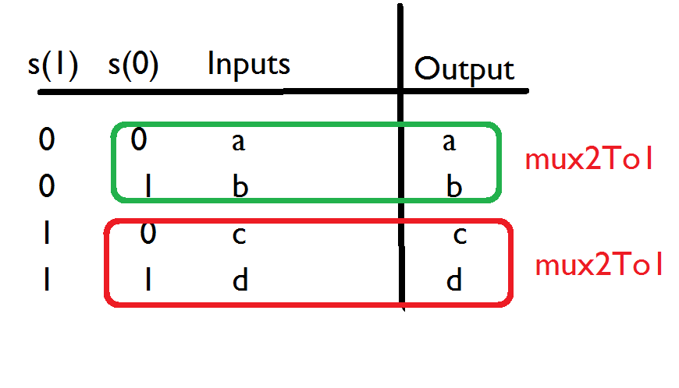

Slide 10
mux2To1
library IEEE;
use IEEE.STD_LOGIC_1164.ALL;
entity mux2To1 is
( a,b,s: in std_logic;
c: out std_logic
);
end mux2To1;
architecture logic_function of mux2To1 is
begin
with s select
c<= a when ‘0’
b when ‘1’;
end logic_function;

Slide 11
mux4To1 using 3 mux2To1
library IEEE;
use IEEE.STD_LOGIC_1164.ALL;
entity mux4To1 is
( a,b,c,d: in std_logic;
s:in std_logic_vector (1 downto 0);
x: out std_logic
);
end mux4To1;
architecture logic_function of mux4To1 is
signal m:std_logic_vector(1 downto 0);
begin
mux1:entity work.mux2To1
port map( a=>a,b=>b,s=>s(0),c=>m(0) );
mux1:entity work.mux2To1
port map( a=>c,b=>d,s=>s(0),c=>m(1) );
mux1:entity work.mux2To1
port map( a=>m(0),b=>m(1),s=>s(1),c=>x);
end logic_function;

Slide 12
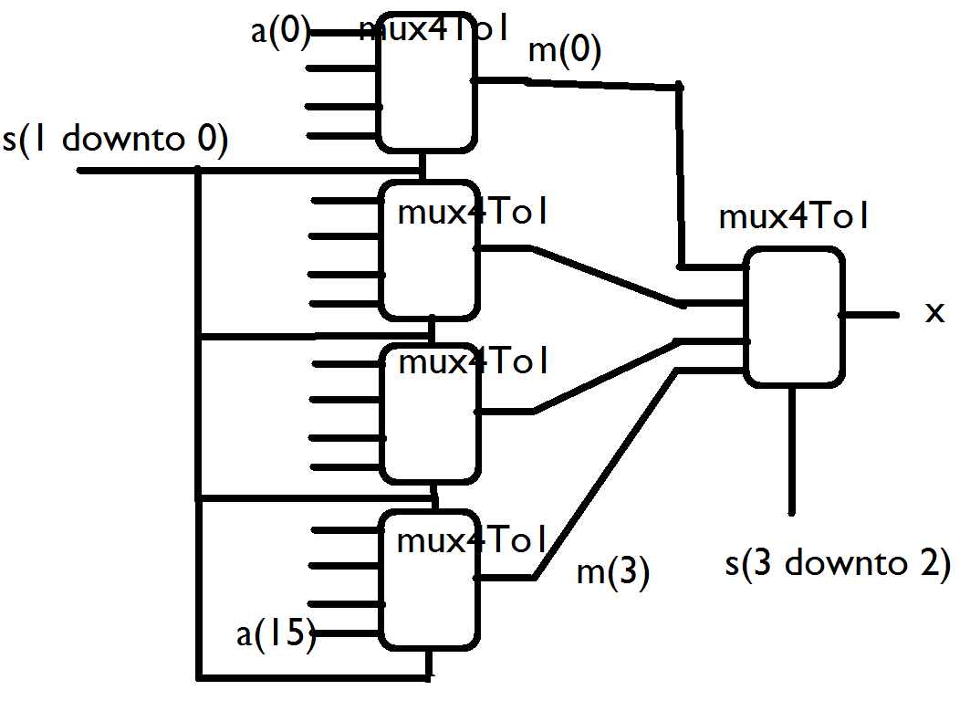
16 to 1 multiplexer using instances of 4 to 1 mux

Slide 13
Home Work
library IEEE;
use IEEE.STD_LOGIC_1164.ALL;
entity mux16To1 is
( a: in std_logic_vector(15 downto 0);
s:in std_logic_vector (3 downto 0);
x: out std_logic
);
end mux16To1;
architecture logic_function of mux16To1 is
signal m:std_logic_vector(3 downto 0);
begin
………………Home work
end logic_function;

Slide 14

Decoders
used to decode encoded information
n inputs and $2^{n}$ outputs
only one output is asserted at a time
enable input

Slide 15
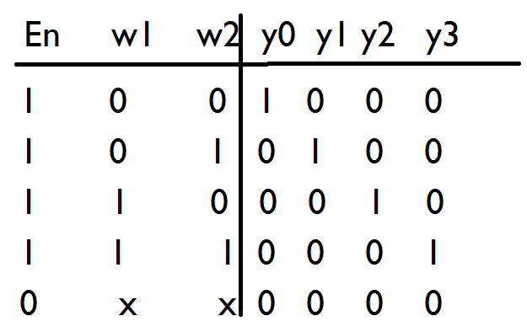
2 to 4 decoder using selected signal assignment

Slide 16
library IEEE;
use IEEE.STD_LOGIC_1164.ALL;
entity dec2To4 is
( w1,w2,En: in std_logic;
y: out std_logic_vector(3 downto 0)
);
end dec2To4;
architecture logic_function of dec2To4 is
signal EnW : std_logic_vector ( 2 downto 0);
begin
EnW <= En &w1&w2;
with EnW select
y <= “0001” when “100”,
“0010” when “101”,
“0100” when “110”,
“1000” when “111”,
“0000” when others;
end logic_function;

